Slide 1
Advance Java MCA 4th sem Topic:-Sturts,CGI,RMI

Slide 2
Struts Framework
The Struts Framework is a standard for developing well-architected Web applications. It has the following features:
Open source
Based on the Model-View-Controller (MVC) design paradigm, distinctly separating all three levels:
Model: application state
View: presentation of data (JSP, HTML)
Controller: routing of the application flow
Implements the JSP Model 2 Architecture
Stores application routing information and request mapping in a single core file, struts-config.xml.

Slide 3
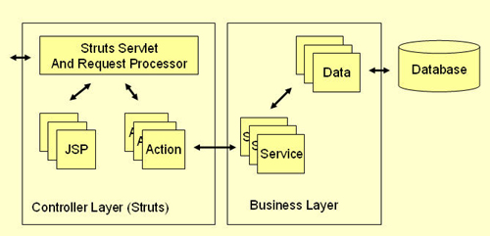
The Struts Framework, itself, only fills in the View and Controller layers. The Model layer is left to the developer

Slide 4
How it works
All incoming requests are intercepted by the Struts servlet controller. The Struts Configuration file struts-config.xml is used by the controller to determine the routing of the flow. This flows consists of an alternation between two transitions:
From View to Action
A user clicks on a link or submits a form on an HTML or JSP page. The controller receives the request, looks up the mapping for this request, and forwards it to an action. The action in turn calls a Model layer (Business layer) service or function.
From Action to View
After the call to an underlying function or service returns to the action class, the action forwards to a resource in the View layer and a page is displayed in a web browser.

Slide 5
Struts Components
The Controller
The struts-config.xml File
Action Classes
View Resources
ActionForms
Model Components

Slide 6
Component Explanation
The Controller
This receives all incoming requests. Its primary function is the mapping of a request URI to an action class selecting the proper application module. It's provided by the framework.
The struts-config.xml File
This file contains all of the routing and configuration information for the Struts application. This XML file needs to be in the WEB-INF directory of the application.
Action Classes
It's the developer's responsibility to create these classes. They act as bridges between user-invoked URIs and business services. Actions process a request and return an ActionForward object that identifies the next component to invoke. They're part of the Controller layer, not the Model layer.

Slide 7
View Resources
View resources consist of Java Server Pages, HTML pages, JavaScript and Stylesheet files, Resource bundles, JavaBeans, and Struts JSP tags.
ActionForms
These greatly simplify user form validation by capturing user data from the HTTP request. They act as a "firewall" between forms (Web pages) and the application (actions). These components allow the validation of user input before proceeding to an Action. If the input is invalid, a page with an error can be displayed.

Slide 8
Model Components
The Struts Framework has no built-in support for the Model layer. Struts supports any model components:
JavaBeans
EJB
CORBA
JDO
any other

Slide 9
CGI PROGRAMMING
The Common Gateway Interface (CGI) is a standard for writing programs that can interact through a Web server with a client running a Web browser. These programs allow a Web developer to deliver dynamic information (usually in the form of HTML) via the browser. A CGI program can be written in any language, including Java, that can be executed by your Web server. CGI programs are commonly used to add search engines, guest-book applications, database-query engines, interactive-user forums, and other interactive applications to Web sites.
In very basic terms, a CGI program must interpret the information sent to it, process the information in some way, and generate a response that will be sent back to the client.

Slide 10
Most of the input to a CGI program is passed into it through environment variables. This will demonstrate how to send these environment variables to a Java CGI program. The rest of the input (if any) is passed into a CGI program as standard input that can be read directly by your program.
The processing can be as simple as appending information to a file or as complex as requesting data from a database.
Since a CGI program can return a myriad of document types, a CGI program must place a short header (ASCII text) on its output so that the client will know how to interpret the information it generates. Most commonly, CGI programs generate HTML. Below, you will find a library of functions including one that generates the appropriate header for HTML. Following the header, a CGI program simply generates the body of the output in its native form.

Slide 11
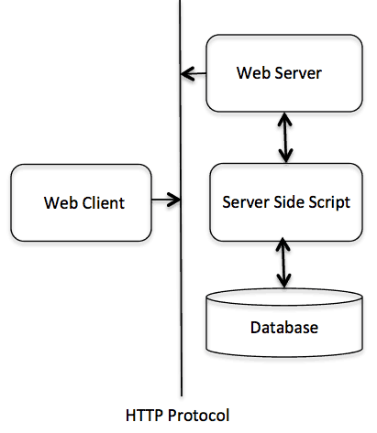

Slide 12
A Java CGI library
A Java CGI library
To ease the tedious task of processing the CGI inputs, I have written a Java class (really a library of functions) that you can utilize to cut down on some of the dirty work. This library attempts to duplicate the functionality in the very popular Perl cgi-lib.pl library. I have documented the code below using javadoc-style comments so that you can generate HTML documentation directly from the code. (Use javadoc cgi_lib.java to generate cgi_lib.html.)

Slide 13
Java CGI program
Here's an example that shows how the cgi_lib.java library can be used to write a CGI program. We'll write a simple program that processes my "Hello There" form. This simple form will prompt the user for a name and email address. Here is the form (hello.html) that we want to process:
<html>
<head>
<title>HELLO AND WELCOME</title>
</head>
<body>
<form method=”post” action=”/cgi-bin/hello.cgi”>
What is your name?
<input type=”text” name=”name” value=” ”>
What is your email Address?
<input type=”text” name=”email” value=” ” size=40>
<input type=”submit” value=”Submit ”>
</form>
</body>
</html>

Slide 14
A Java program to process the "Hello There" form
First, we need to let the client know that our program will be generating HTML. The Header() method in cgi_lib.java creates the string we need, so we'll start by calling that method and sending the string to standard out using the System.out.println system call.
import java.util.*;
import java.io.*;
class hello{
public static void main( String args[] )
{
//Here is a minimalistic CGI program that uses cgi_lib
//Print the required CGI header.

Slide 15
System.out.println(cgi_lib.Header());
// Parse the form data into a Hashtable.
Hashtable form_data = cgi_lib.ReadParse(System.in);
// Create the Top of the returned HTML page
String name = (String)form_data.get("name"); System.out.println(cgi_lib.HtmlTop("Hello There " + name + "!"));
System.out.println("&lth1 align=center&gtHello There " + name + "!</h1>"); System.out.println("Here are the name/value pairs from the form:");
// Print the name/value pairs sent from the browser.
System.out.println(cgi_lib.Variables(form_data));

Slide 16
// Print the Environment variables sent in from the Unix script.
System.out.println("Here are the CGI environment variables/value pairs" + "passed in from the UNIX script:"); System.out.println(cgi_lib.Environment());
// Create the Bottom of the returned HTML page to close it cleanly.
System.out.println(cgi_lib.HtmlBot());
}
}
We are using the get method on the Hashtable object to extract the form values into strings that we can use in our program.

Slide 17
RMI
RMI stands for Remote Method Invocation. It is a mechanism that allows an object residing in one system (JVM) to access/invoke an object running on another JVM. RMI is used to build distributed applications; it provides remote communication between Java programs. It is provided in the package java.rmi.
It is an API which allows an object to invoke a method on an object that exists in another address space, which could be on the same machine or on a remote machine. Through RMI, object running in a JVM present on a computer (Client side) can invoke methods on an object present in another JVM (Server side). RMI creates a public remote server object that enables client and server side communications through simple method calls on the server object.

Slide 18
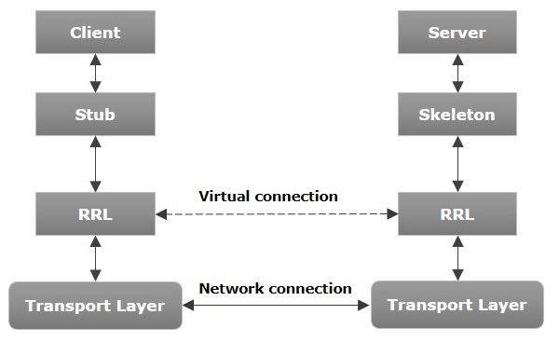
Architecture of an RMI Application

Slide 19
Architecture Explained
In an RMI application, we write two programs, a server program (resides on the server) and a client program (resides on the client).
Inside the server program, a remote object is created and reference of that object is made available for the client (using the registry).
The client program requests the remote objects on the server and tries to invoke its methods.

Slide 20
Components of the Architecture
Transport Layer − This layer connects the client and the server. It manages the existing connection and also sets up new connections.
Stub − A stub is a representation (proxy) of the remote object at client. It resides in the client system; it acts as a gateway for the client program.
Skeleton − This is the object which resides on the server side. stub communicates with this skeleton to pass request to the remote object.
RRL(Remote Reference Layer) − It is the layer which manages the references made by the client to the remote object.

Slide 21
Working of an RMI Application
The following points summarize how an RMI application works −
When the client makes a call to the remote object, it is received by the stub which eventually passes this request to the RRL.
When the client-side RRL receives the request, it invokes a method called invoke() of the object remoteRef. It passes the request to the RRL on the server side.
The RRL on the server side passes the request to the Skeleton (proxy on the server) which finally invokes the required object on the server.
The result is passed all the way back to the client.

Slide 22
Marshalling and Unmarshalling
Whenever a client invokes a method that accepts parameters on a remote object, the parameters are bundled into a message before being sent over the network. These parameters may be of primitive type or objects. In case of primitive type, the parameters are put together and a header is attached to it. In case the parameters are objects, then they are serialized. This process is known as marshalling.
At the server side, the packed parameters are unbundled and then the required method is invoked. This process is known as unmarshalling.

Slide 23
RMI Registry
RMI registry is a namespace on which all server objects are placed. Each time the server creates an object, it registers this object with the RMIregistry (using bind() or reBind() methods). These are registered using a unique name known as bind name.
To invoke a remote object, the client needs a reference of that object. At that time, the client fetches the object from the registry using its bind name (using lookup() method).

Slide 24
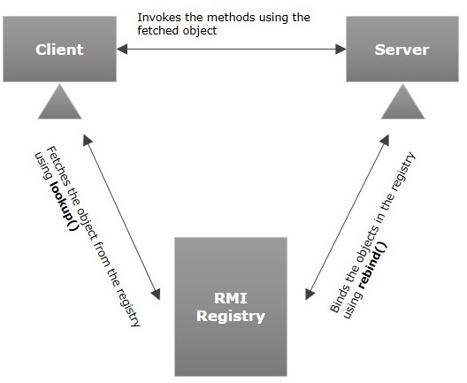
RMI Registry Process

Slide 25
Goals of RMI
Following are the goals of RMI −
To minimize the complexity of the application.
To preserve type safety.
Distributed garbage collection.
Minimize the difference between working with local and remote objects.

Slide 26
Thanks…………

